Slide 1
BASE SAS
&
SAS MACROS
Training
By
Nilesh Sagale
29-Nov-2006 to 08-Dec-2006

Slide 2
Objectives of the course
Introduction to the world of SAS
  History and overview of SAS
  Explore the SAS environment for programming
  Understand syntax rules
  Understand the concept of SAS data libraries
  Understand DATA and PROC steps
Programming with the DATA step
  Reading SAS datasets [SET statement]
  Modifying datasets [SET statement]
  Subsetting datasets [IF, WHERE statements]
  Executing statements conditionally [If-Then-Else]
  Writing repetitive code [Do-While]
  Outputting multiple observations
  Writing to multiple SAS datasets
  Creating running totals for a variable
A G E N D A

Slide 3
Objectives of the course
Introduction to PROC step
  Understand the PRINT, CONTENTS and SORT procedure
  Understand the FREQ, MEANS, FORMAT, SUMMARY, DATASETS and TRANSPOSE procedures
Advanced SAS programming
  Understand the SAS date-time concepts
  Understand and use SAS functions
  Appending SAS datasets [SET, APPEND]
  Combining datasets [MERGE statements]
  Understand PROC SQL procedure
  Read data into SAS from non-SAS files
  Write data from SAS to non-SAS files
World of macros
  Introduction to macro variables
  Introduction to macros
  How to develop, use and debug macros
  Understand macro functions
A G E N D A

Slide 4
Session 1

Slide 5
Objectives of the Session
Understand SAS and its history
Understand technologies where SAS is used
Understand industries where SAS is used
Understand a typical SAS program
Become familiar with SAS environment
Understand syntax rules
Understand the concepts of data libraries
Understand DATA and PROC steps
A G E N D A

Slide 6
What is SAS ?
“SAS is an integrated software providing complete control over
data access, management, analysis and presentation”.
- SAS Institute

Slide 7
About SAS
The development of SAS Institute
  1960’s North Carolina State University – Dr. Jim Goodnight
  1976 SAS Institute USA
  1980 SAS Software UK
  1982 SAS Institute Germany
  2000 Worldwide S/W services operations, Pune, India
User group meetings
  SEUGI European Conference
  SUGI USA Conference
  VIEWS UK Conference
  SUGA Asia/Pacific Conference
  SIUG India Conference
4GL (Fourth Generation Language) – allows to develop applications, query databases and produce reports
Runs on multiple platforms (MVS, UNIX, VMS, OS/2, PC,…)
Platform independent programs
World’s largest privately held software company [Revenue – USD 1.68 b in 2005 ; 24% of revenue spend on R & D]

Slide 8




The SAS® System
The software industry can be divided into four main areas
Office and communications Software for enhancing personal productivity
Operational Applications (such as ERP Systems)
Transactional Database Software
Information Delivery Systems
SAS

Slide 9
The SAS® System
Some technologies where the SAS System is used
  Data Warehousing (Warehouse-administrator, SAS/MDD, SAS/Access)
  Business Intelligence/OLAP (SAS/EIS, Enterprise Reporter)
  Applications Development (SAS/AF)
  Data Mining (Enterprise Miner)
  Statistical Analysis (SAS/STAT, SAS/QC, SAS/ETS, SAS/IML, …..)
  Web Enablement (AppDev Studio, SAS IntrNet)
  Client Server (SAS/Connect, SAS/Share)
  …….

Slide 10
The SAS® System
Some other Analysis and Reporting tools of the SAS System
  SAS/Assist
  SAS/FSP
  SAS/Graph
  SAS/OR
  SAS/Toolkit
  …….
This is only a sample of the existing SAS modules and packages

Slide 11
The SAS® System
Some Industry sectors where the SAS System is present
  Banking and Financial Services
  Colleges and Universities
  Government and Public Sector
  Health Care
  Insurance
  Manufacturing
  Pharmaceuticals
  Retail
  Telecommunications
  Utilities
  …..

Slide 12
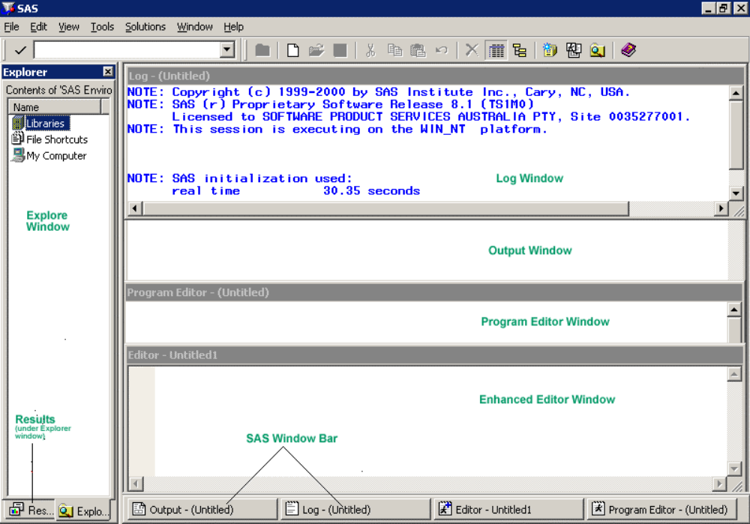
SAS Environment

Slide 13
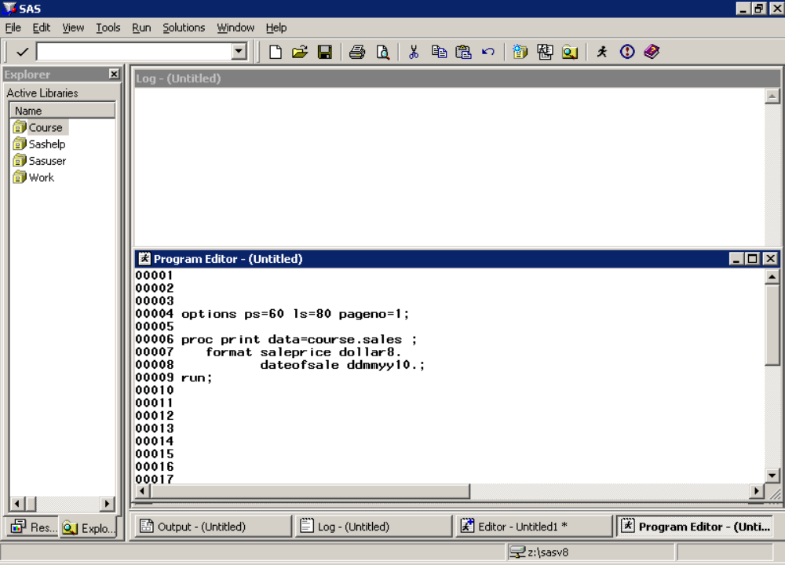
Program Editor Window

Slide 14
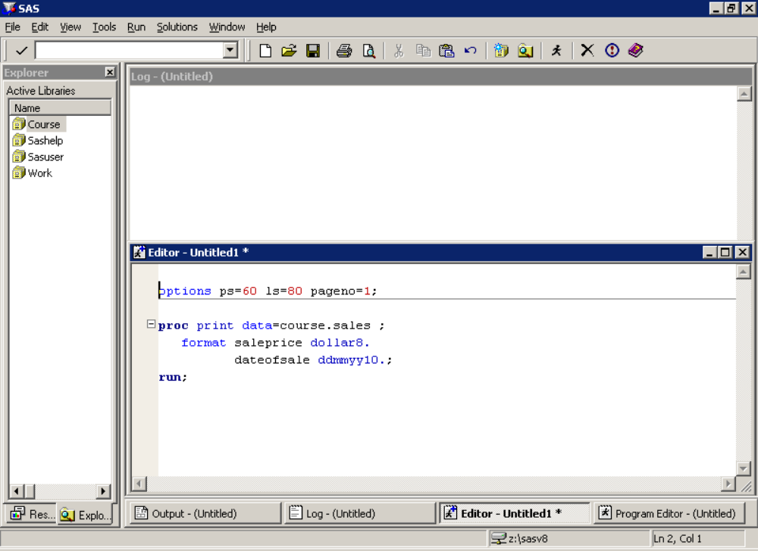
Enhanced Editor Window

Slide 15
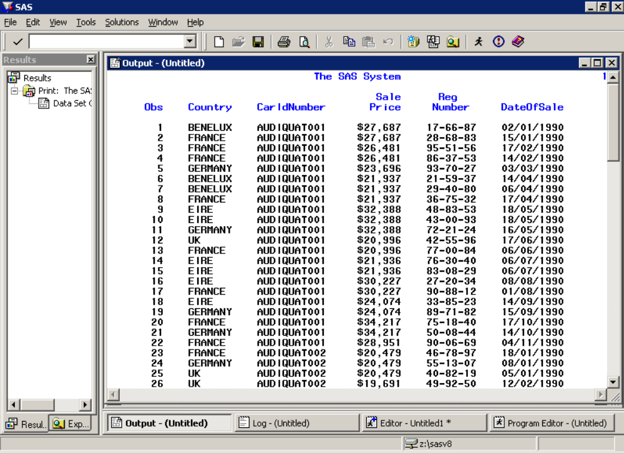
Output Window

Slide 16
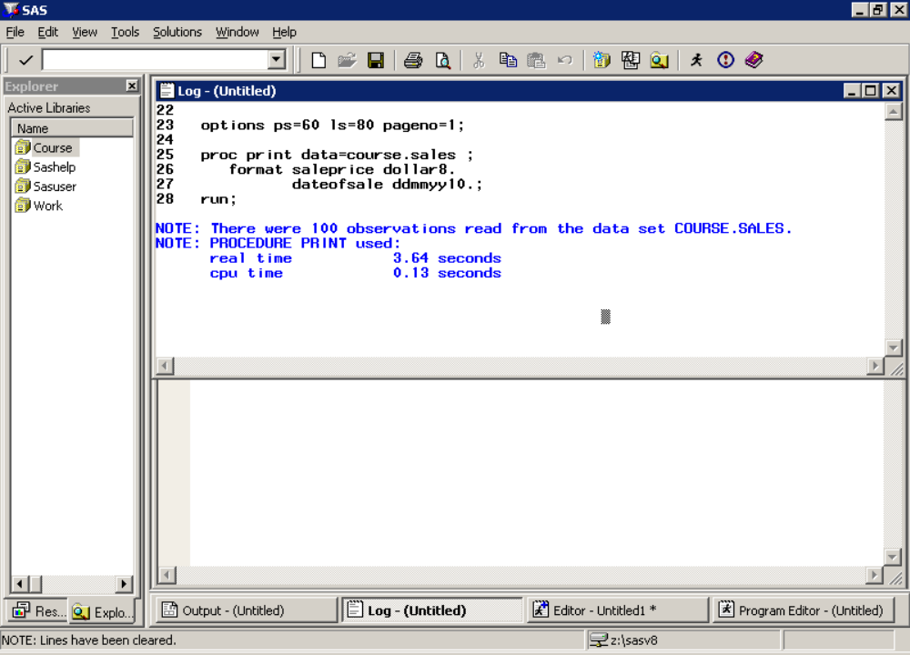
Log Window

Slide 17
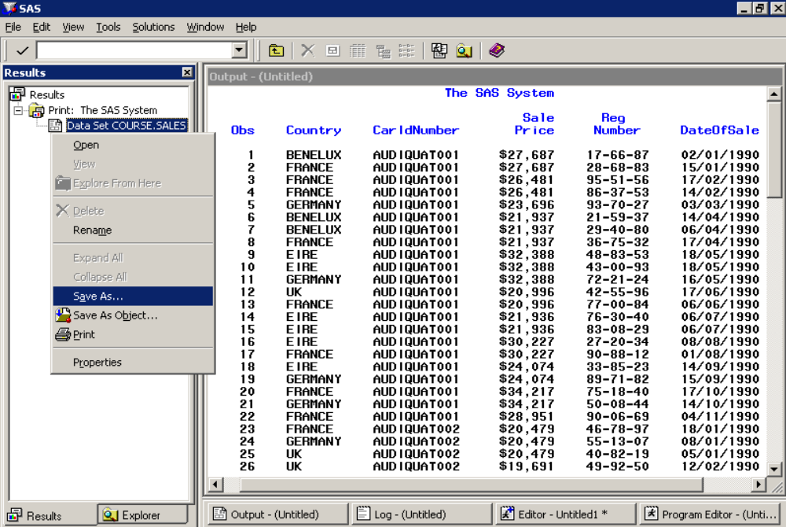
Results Window to Manage Output

Slide 18
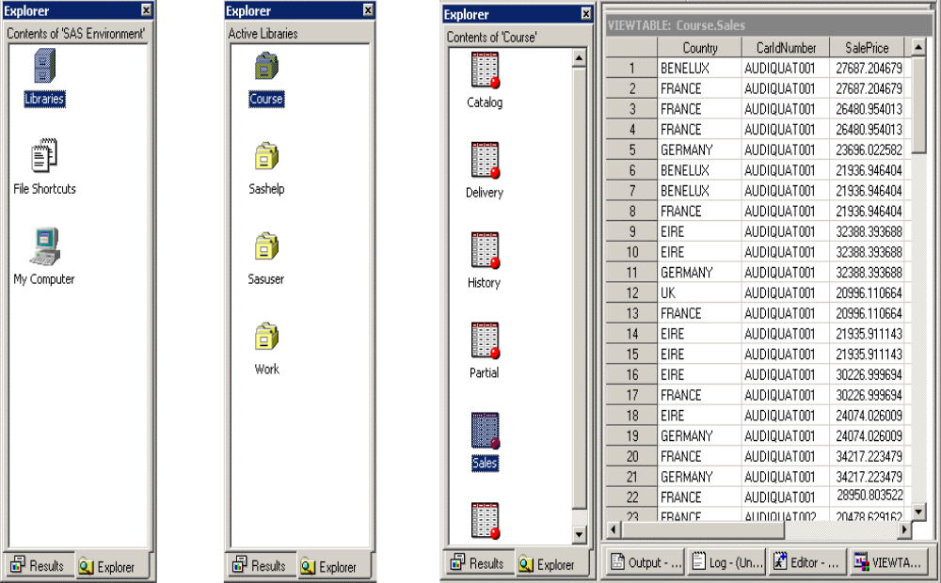
Explorer Window

Slide 19
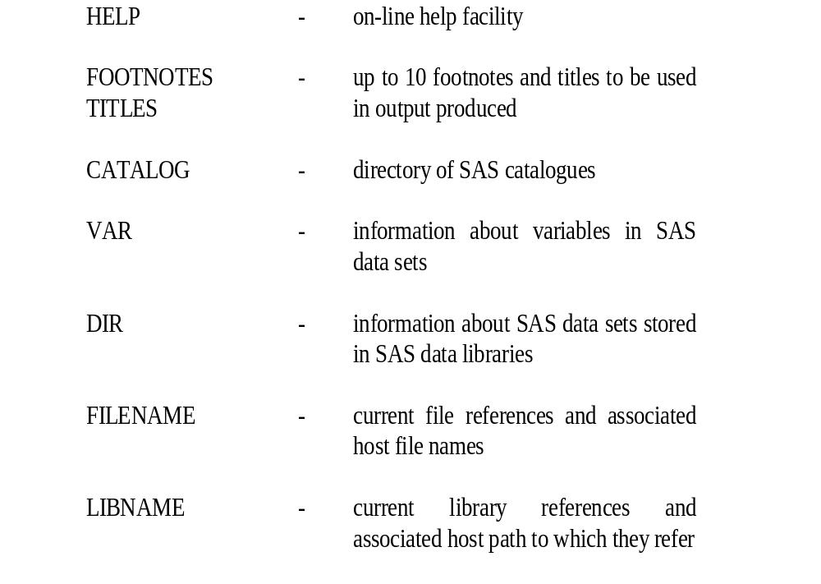
Other Types of Windows

Slide 20
Referencing External Files
Syntax : Filename Statement
    FILENAME fileref 'filename' ;
Examples
    FILENAME xtrn ‘a:\course.sas’;
    FILENAME xtrn1 ‘myfile.sas’;
    FILENAME car_dat ‘c:\data\cars.dat’;

Slide 21
LIBNAME Statement
Syntax : Libname Statement
    LIBNAME libref engine ‘external file’ options;
Syntax : Access Option
    ACCESS = READONLY
Example
    LIBNAME course ‘c:\’ ACCESS = READONLY;

Slide 22
LIBNAME Statement
Examples
    LIBNAME sasdb ‘S:\’;
    LIBNAME sasdb ‘S:\’ ACCESS = READONLY;
    LIBNAME sasdb CLEAR;
    LIBNAME _ALL_ CLEAR;

Slide 23
SAS Libraries
Permanent
  LIBNAME sasdb ‘S:\’;
Temporary
  WORK – default temporary library
  USER – overrides WORK in case assigned
  SASHELP – stores info about SAS session
  SASUSER – stores personal settings for users [SASUSER.PROFILE]

Slide 24
DATA step and PROC step
SAS Data Step
  Creation and Modification
SAS Proc Step
  Analysis and Reporting
Used together, produces a complete program

Slide 25
A typical SAS program
DATA extract;
    SET pdb.jobs;
    IF DATEPART(jstrtime)=TODAY()-1;
    RUN;
    PROC SUMMARY DATA = extract;
    CLASS jobclass;
    VAR cputm;
    OUTPUT OUT=clss_cpu SUM=sum_cpu;
    RUN;
    PROC PRINT DATA = clss_cpu LABEL;
    ID jobclass;
    VAR sum_cpu;
    FORMAT sum_cpu TIME 11.2;
    LABEL sum_cpu= 'CPU CONSUMED';
    TITLE1 'CPU CONSUMED BY JOBCLASS';
    RUN;

Slide 26
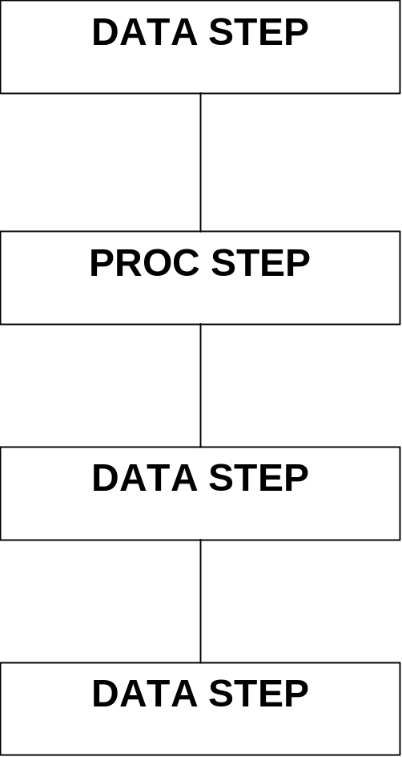
DATA and PROC steps

Slide 27
DATA and PROC steps
Syntax - DATA step
    DATA _________________;
    SET ________________;
    ____________________;
    ____________________;
    ____________________;
    RUN;

Slide 28
DATA and PROC steps
Data Step Example
    DATA newsales;
    SET course.sales;
    IF dateofsale GE '01JAN90'D THEN OUTPUT;
    RUN;

Slide 29
DATA and PROC steps
Syntax - PROC STEP
    PROC ____________________;
    ____________________;
    ____________________;
    ____________________;
    RUN;

Slide 30
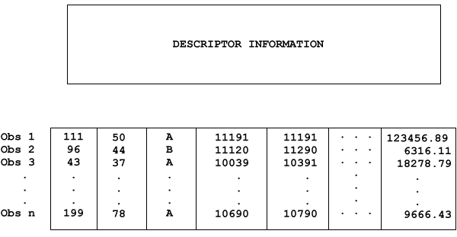
Structure of SAS datasets

Slide 31
SAS data sets
  SAS Data Sets are also called Tables
  Observations are also called Rows
  Variables are also called Columns

Slide 32
SAS Variables - What are they?
SAS names
  Variables, data set names, formats, arrays, statement labels, librefs and filerefs
  Variable and table names up to 32 characters (8 in version 6)
  Librefs and filerefs names up to 8 characters
  Format names up to 7 characters
  Begin with A-Z or an _
  Continue with A-Z, 0-9 or an _
  Insensitive to case

Slide 33
SAS Variables - What are they?
Examples of SAS names
    fred temp
    var1 sps_code
    p_code variable
    ds_one saslib
    x257 day_5

Slide 34
SAS Variables - What are they?
Numeric Variables
  values held contain numbers
  plus a decimal point
  + or - sign
  but NOT commas
Character Variables
  character strings or character literal

Slide 35
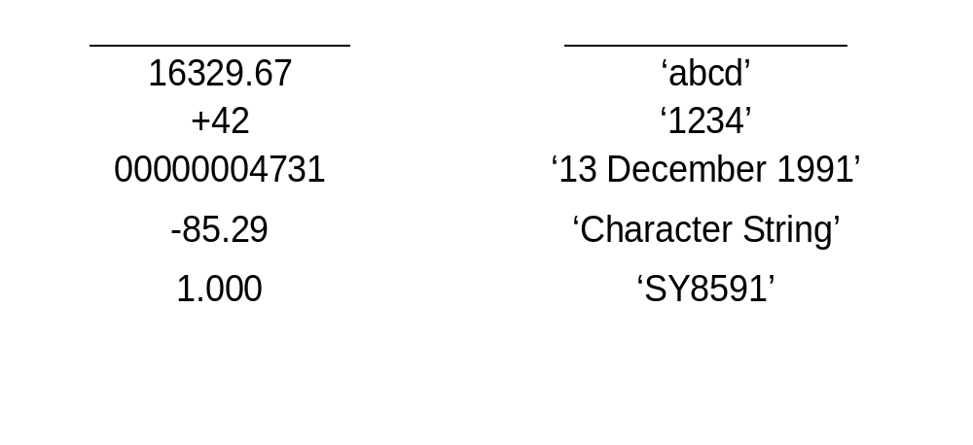
SAS Variables - What are they?

Slide 36
SAS Variables - What are they?
Specifying Missing Values
  Numeric (A Full Stop)
  Character (A Blank)
    num1 = . ; char2 = ' ' ;
    salary = . ; name = ' ' ;

Slide 37
SAS Variables - What are they?
SAS Variable Lists
    var1 var2 var3 var4 ===>var1 - var4
    x3 x4 x5 x6 x7 x8 x9 x10 ===>x3 - x10

Slide 38
Attributes of SAS Variables
Types of SAS variables
  Numeric
  Character
Length
Formats
Labels
Attributes held for each variable in data set
Attributes may be permanently changed or modified during a data step

Slide 39
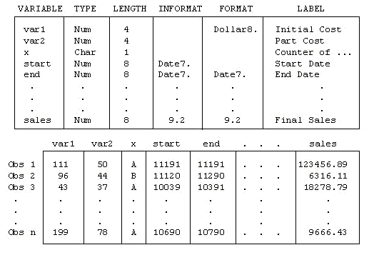
Attributes of SAS Variables

Slide 40
Attributes of SAS Variables
TYPE
  Character Character String
  Numeric Numbers
LENGTH
  Numeric Default of 8 bytes (Range from 2-8 bytes)
  Character 1 to 32,767 characters

Slide 41
Attributes of SAS Variables
LABEL
  Descriptive text or label used to better describe or document SAS variables. The label may be printed out instead of the actual SAS variable name
  Up to 256 characters

Slide 42
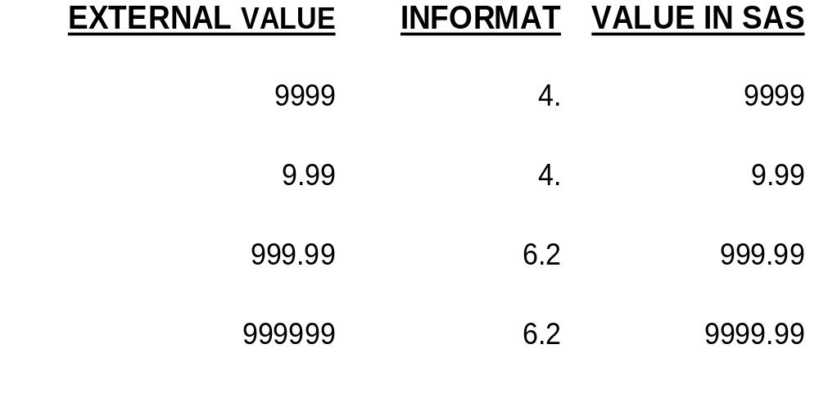
Attributes of SAS Variables
INFORMAT
  Pattern used by SAS to read values into a SAS variable.

Slide 43
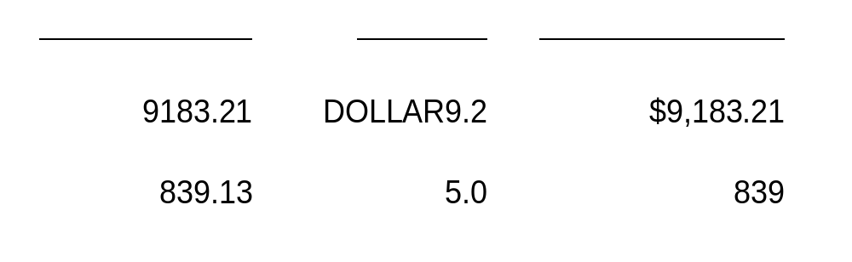
Attributes of SAS variables
FORMAT
  Pattern used by SAS to write or print out the values held in SAS variables

Slide 44
Comment Your SAS Code
Embedded Comment
    /* . . . */
Comment Statement
    * . . . ;

Slide 45
Comment Your SAS Code
Example
    * -------------------------- *;
    * Example of a Box Comment *;
    * -------------------------- *;
    DATA one error;
    SET temp;
    IF year EQ 45 AND ctr NE 'G' AND
    /* value EQ 83 AND */ code NE 'I';
    *IF age LT 20 THEN OUTPUT error;
    RUN;
    * -------------------------- *;
    * Another Box Comment *;
    * -------------------------- *;

Slide 46
Rules for Writing SAS Code
Free Format
Must end with a semicolon (;)
Usually begins with a SAS keyword

Slide 47
Rules for Writing SAS Code
Two SAS data steps
    data CARS ERROR; SET course.history;
    month_stock=numberdelivered-numbersold; IF MONTH>12 then
    output error;
    ELSE OUTPUT CARS;RUN;
    OR
    DATA cars error;
    SET course.history;
    month_stock=numberdelivered-numbersold;
    IF month GT 12 THEN OUTPUT error;
    ELSE OUTPUT cars;
    RUN;

Slide 48
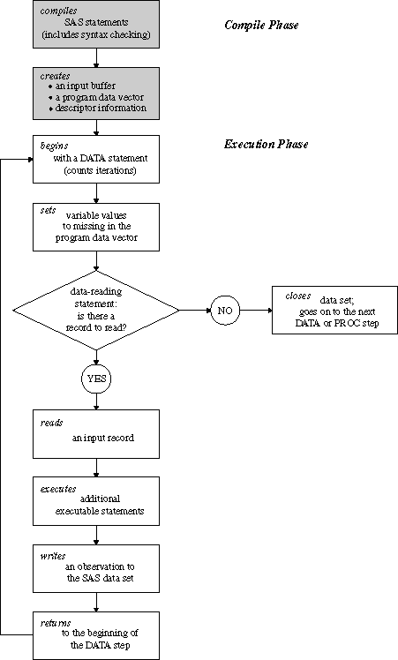
What is a SAS Data Step?

Slide 49
How to Code a Data Step
Example of a complete DATA step
    /* subset the master delivery */
    /* data set to only records with */
    /* 6 or more cars being delivered */
    DATA delv_6;
    SET course.delivery;
    IF numberdelvd GE 6;
    *calculate average cost per car;
    avg_cost = cost / numberdelivered;
    RUN;

Slide 50
How to Code a Proc Step
Example
    /* print out info on deliveries */
    /* after 1 JAN 1991 that cost */
    /* 100,000 or over */
    PROC PRINT DATA = cst_100k;
    WHERE cost GE 100000 AND
    deliverydate GE '01JAN91'D;
    VAR caridnumber cost deliverydate;
    TITLE1 'Deliveries After 1 January 1991';
    TITLE2 'Costs Greater than $100,000';
    RUN;

Slide 51
Its Quiz Time
Who is the founder of SAS Institute ?
What are different windows in SAS environment ?
What is the use of DATA step ?
What is the use of PROC step ?
What is the default data library of SAS ?
What is the limitation of naming SAS variables?
What are different types of SAS variables ?
What are different attributes of SAS variables ?
How to comment the code in SAS program ?
Every SAS line of code end with -------- ?

